Slide 1
Health Monitor Kit
Harrison Chen | Jeffrey Chen | Justin Khoo

Slide 2
Design & Application
Wearable/Portable
Monitors your health
Low Power Consumption
Smart
Determine well-being of user
Prevent/minimize health problems in advance
Related to Electrical Engineering
Hardware fabrication
Real-time sensor data collection
Low power concerns

Slide 3
Objectives
Accurate sensors
Low Power Consumption
Small size
Data analysis and trends

Slide 4
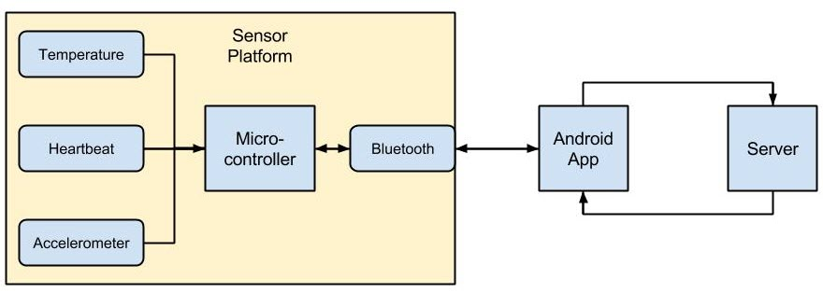
High Level Architecture

Slide 5
Challenges
Low power
Accurate
Portability/Wearable

Slide 6
Design Considerations
$200 budget
Size/Portability
Will eventually be comfortably wearable
Rechargeable
25 mA when awake & powered
Negligible μA usage when on low power
Usage
NOT a medical device
Cost of final product
Affordable for the average user
Versatility / Robust
Able to withstand the wear and tear of daily use for years

Slide 7
Work Flow
Harrison Chen
Android
Server
Bluetooth Communications
Jeffrey Chen
Hardware/Electrical Design
Bluetooth Communications
Justin Khoo
Android
Hardware/Electrical Components
Database
Location

Slide 8
Packaging it together
What we have
Arduino-based sensor platform
Temperature working
Heartbeat requires more calibration
Server
Geolocation
What we plan on doing
Shrinking sensor platform
Creating a prototype package
Reading Blood O2 from reflection-based oximetry
Analyzing data to create graphs and trends

Slide 9
Demo

Slide 10
Acknowledgment
Dr. Gang Chen

